Slide 1
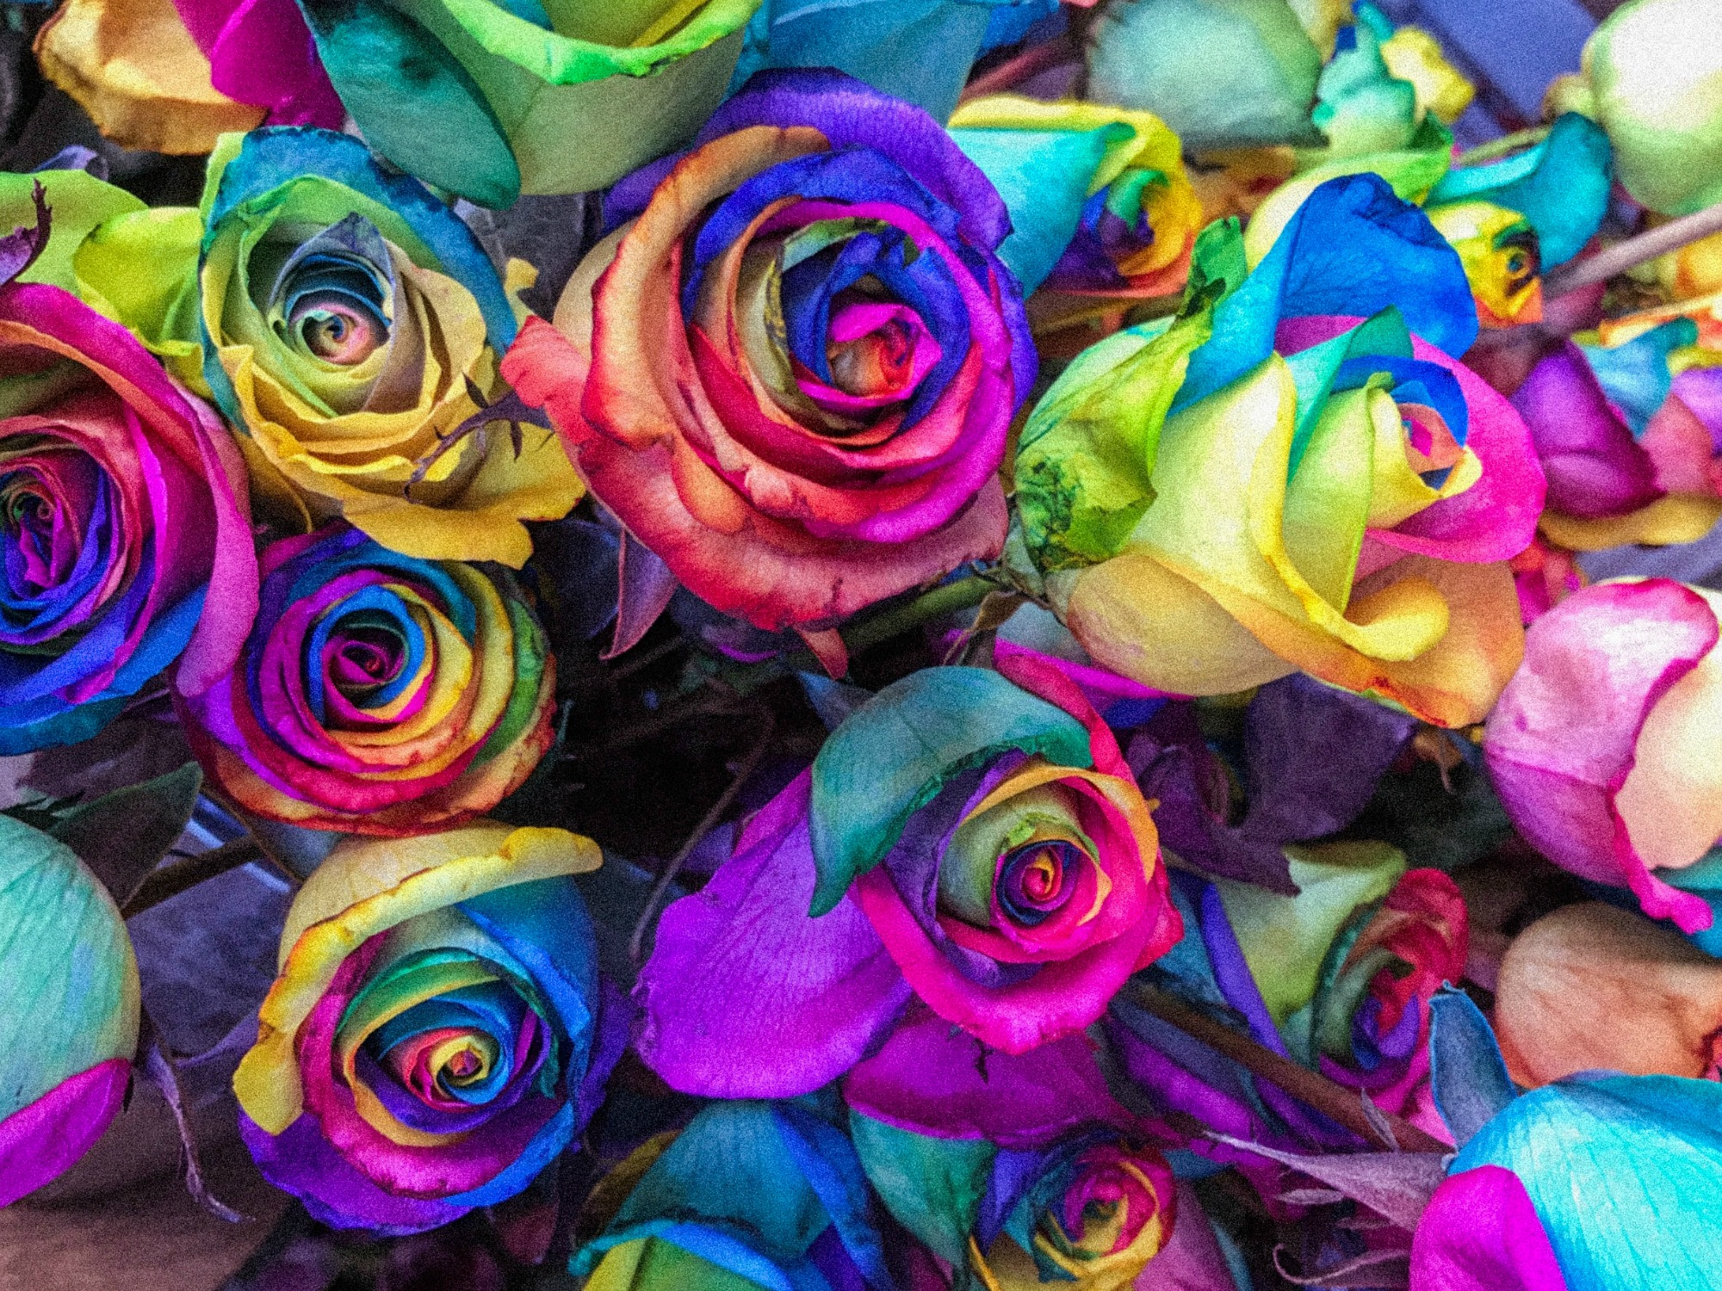
Diversity, Otherness and Privilege
A guide for conversation
Susanna Wesley Foundation

Slide 2



Agreed ground rules
Take time to talk together about your group’s agreed discussion guidelines*
* See Facilitator Guide
Susanna Wesley Foundation

Slide 3
Unconscious bias
Watch this video for an introduction to unconscious bias.
https://youtu.be/dVp9Z5k0dEE
Susanna Wesley Foundation

Slide 4




Introduction
What do we think and what do we do when we notice difference, and when we experience difference in others?
Susanna Wesley Foundation

Slide 5
Experiences of 'Us’ and ‘Them’
Which of the diagrams on the handout represent your experiences, both as the ‘us’ and the ‘them’?
Susanna Wesley Foundation

Slide 6
Assimilation - make ‘them’ like ‘us’
Susanna Wesley Foundation

Slide 7
Rejection - send ‘them’ away from ‘us’
Susanna Wesley Foundation

Slide 8
Syncretisation - mix ‘them’ up with ‘us’
Susanna Wesley Foundation

Slide 9
Conversion -
‘we’ become like ‘them’
Susanna Wesley Foundation

Slide 10
Toleration - allow ‘them’ space alongside ‘us’
Susanna Wesley Foundation

Slide 11
New Creation - discover new combinations and patterns
Susanna Wesley Foundation

Slide 12


Otherness
Labelling or treating a group or individual as ‘other’ is an attempt to have power, to place oneself at the centre, as the norm.
Susanna Wesley Foundation

Slide 13

Otherness
We are relational beings –
we can only flourish in community.
Susanna Wesley Foundation

Slide 14

Otherness
Question:
Have you come across the words ‘otherness’ or ‘othering’? How do you feel about these terms?
Susanna Wesley Foundation

Slide 15

Otherness
Question:
When have you experienced being made to feel like an ‘other’; how would you describe this experience and its relationship to power?
Susanna Wesley Foundation

Slide 16

Otherness
Question:
When have you - intentionally or not - ‘othered’ someone; in other words, made them feel like they were different from the core group of which you were, or are, a part?
Susanna Wesley Foundation

Slide 17




Privilege
Those with the most privilege have the most power and representation, and the greatest access to
resources.
Susanna Wesley Foundation

Slide 18




Privilege
We often find we are privileged in some ways and not as privileged in other ways.
Susanna Wesley Foundation

Slide 19
Privilege
Question:
When have you felt that others had unearned privilege that you did not have? How did you feel?
Susanna Wesley Foundation

Slide 20
Privilege
Question:
When have you experienced privilege – an awareness that your advantage was due to a characteristic that society favours, rather than having been earned?
Susanna Wesley Foundation

Slide 21
Privilege
Question:
How does the notion of privilege emerge in your faith tradition or worldview, both in its history and its ideas? How does it intersect with ideas about grace, or notions of superiority?
Susanna Wesley Foundation

Slide 22

Diversity
A diverse community is always changing; it requires flexibility, constant communication and acceptance of change.
Susanna Wesley Foundation

Slide 23



Diversity
The most important skill is listening, deeply and lovingly, without an agenda.
Susanna Wesley Foundation

Slide 24
Diversity
Question:
What does your faith tradition or worldview teach about diversity in relation to unity, justice and peace?
What examples does it present of listening and moving outside of one’s comfort zone?
Susanna Wesley Foundation

Slide 25
Diversity
Question:
What challenges does a diverse group bring? Is there ever a reason to have groups with limited diversity?
Susanna Wesley Foundation

Slide 26
Diversity
Question:
What are the benefits of creating diverse communities?
Susanna Wesley Foundation

Slide 27
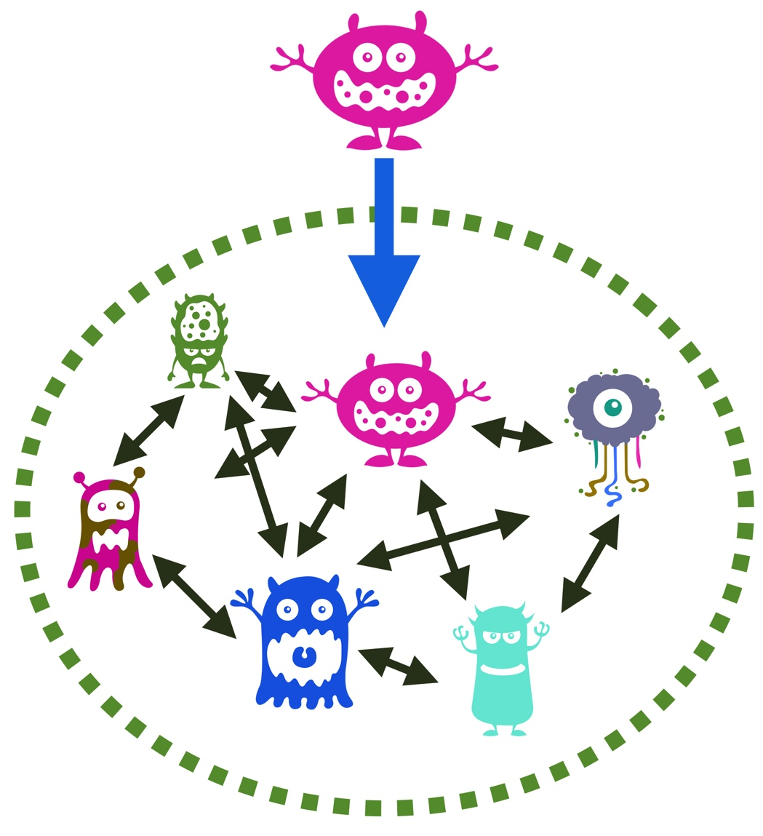
Hopes for community
What will a ‘new creation’ look like? What steps can we take, both individually and together?
Susanna Wesley Foundation

Slide 28
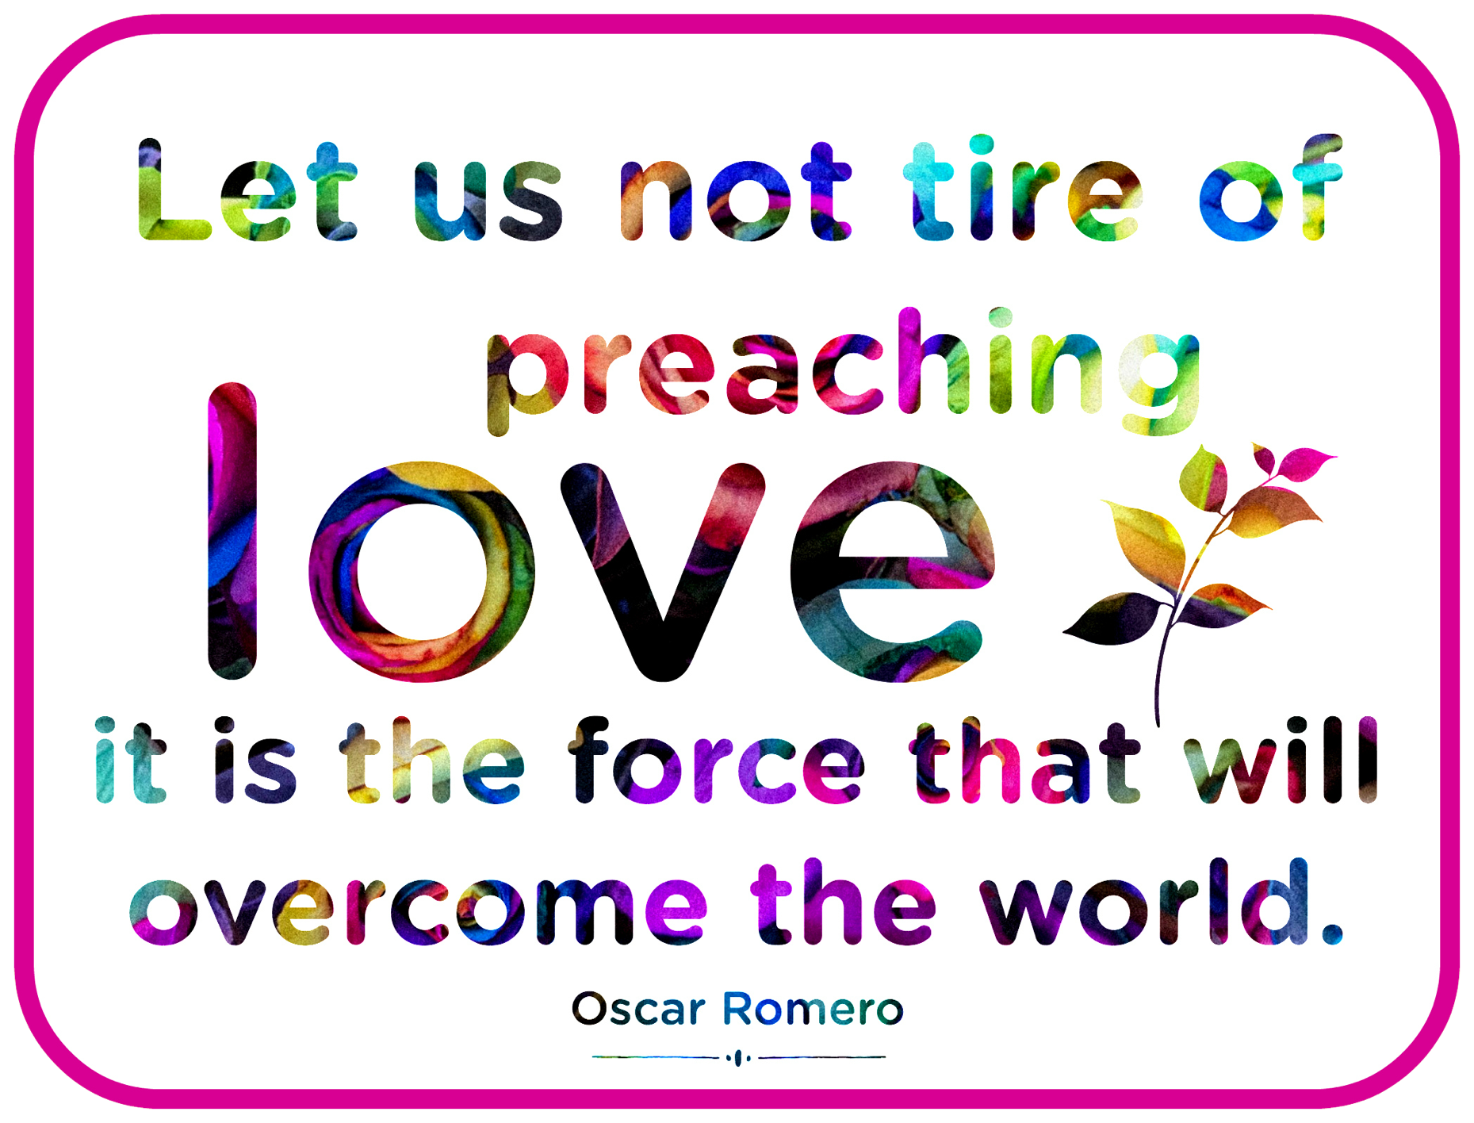
Susanna Wesley Foundation

Slide 29
About this resource
This PowerPoint, produced by the Susanna Wesley Foundation (SWF), is designed to accompany the booklet Diversity, Otherness and Privilege, available from the SWF. It is intended to work alongside the handout of visual models and the Facilitator Guide, available on the SWF website. Together these resources support a series of small group discussions.
This resource pack is intended to help communities to consider all kinds of diversity, and their own sense of otherness and privilege, both individually and, most crucially, in community.
Obviously a resource like this cannot cover this complex topic comprehensively. We trust that it will nonetheless stimulate questions and discussion within communities, and generate conversation, empathy and understanding as an ongoing practice.
susannawesleyfoundation.org
SWF@roehampton.ac.uk
‘critter’ drawings from picmonkey.com
Other content © Susanna Wesley Foundation 2019
Version: July 2019
Susanna Wesley Foundation

